Slide 1
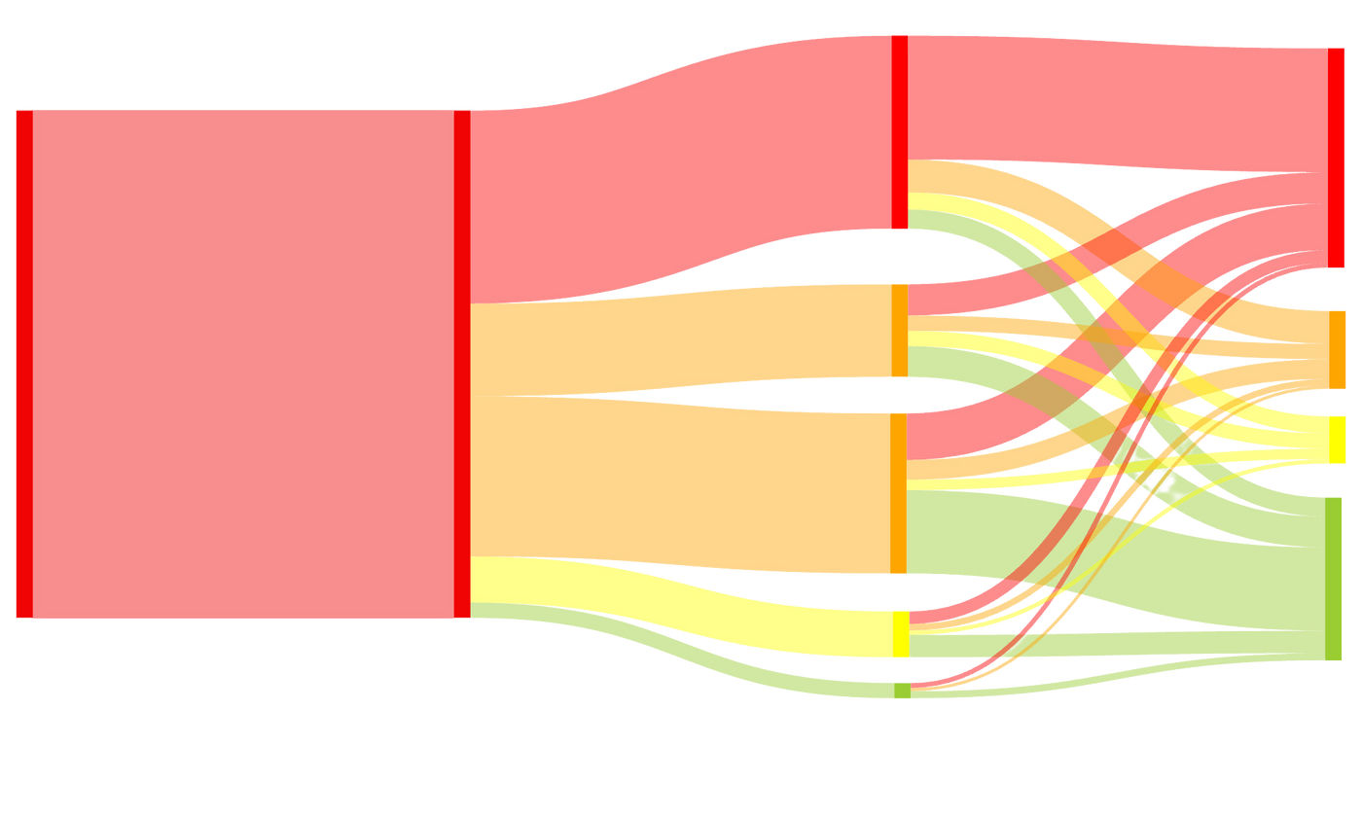
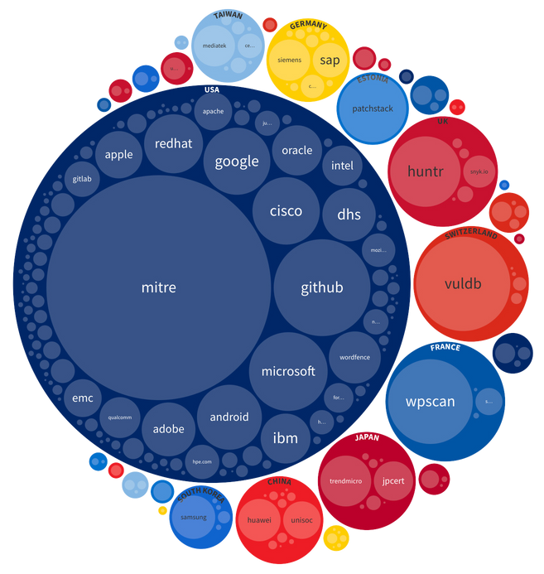

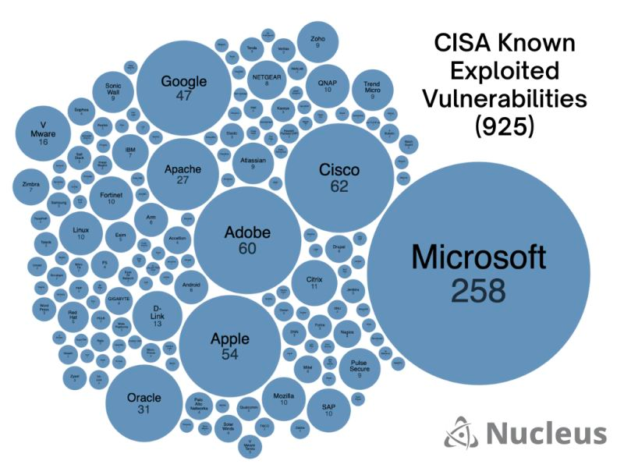



INSIGHTS INTO VULNERABILITY MANAGEMENT
500
400
Patrick Garrity
Security Researcher
300
/in/patrickmgarrity/
200
100
0
1999
2000
2001
2002
2003
2004
2005
2006
2007
2008
2009
2010
2011
2012
2013
2014
2015
2016
2017
2018
2019
2020
2021
2022
2023

Slide 2

KEV

Slide 3
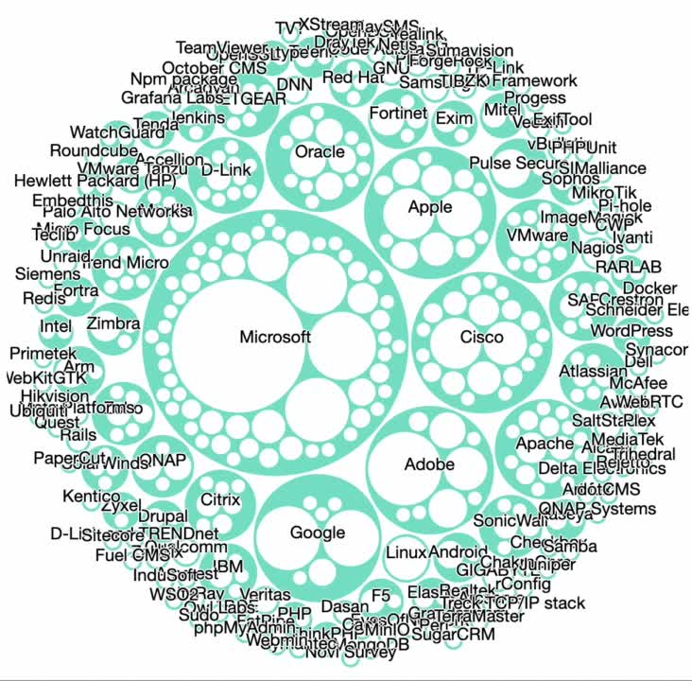

CISA Known Exploited Vulnerabilities (925)
Created By: Patrick Garrity, Security Researcher, Nucleus Security
Notes:
Sifting through the 925 known exploited vulnerabilities listed in the Cybersecurity and Infrastructure Security Agency (#CISA) KEV Catalog can be overwhelming.
After hearing your feedback about wanting to see which products have the most known vulnerabilities on the #KEV, I created an interactive prototype that provides a simple and intuitive way to quickly click and understand which vendors and products have the most vulnerabilities on the CISA KEV.
Spoiler Alert...
While Microsoft Windows leads the list with 96 confirmed exploited vulnerabilities, our prototype allows you to easily explore other top vendors like Cisco and products see products impacted like #macos that are at risk.
Only then can you identify risks and prioritize which actions to take, such as updating a source code library, patching a Windows host, implementing a mitigating control, or often accepting the risk.
Stay tuned for updates from Nucleus Security on the interactive version of the CISA KEV by following my feed. 🔔
LinkedIn Post URL: https://www.linkedin.com/posts/patrickmgarrity_cisa-kev-macos-activity-7061462094746972160-VnhD?utm_source=share&utm_medium=member_desktop

Slide 4
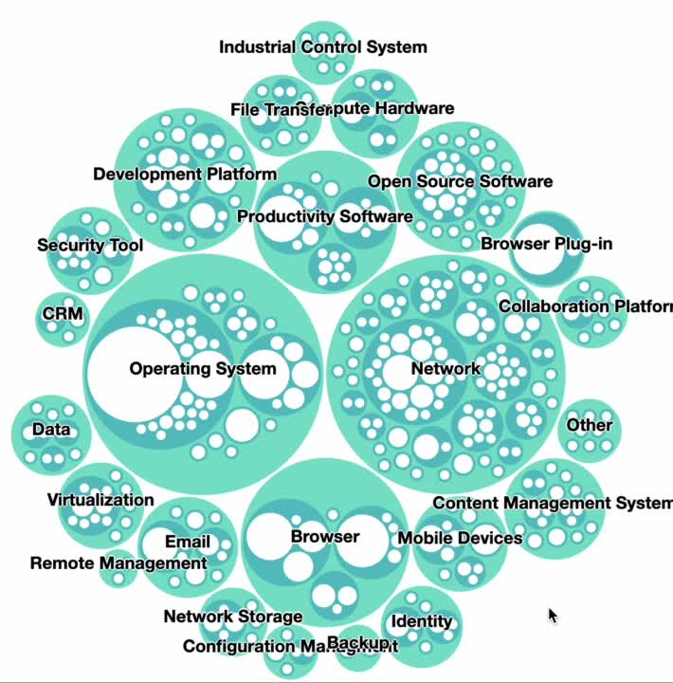

CISA Known Exploited Vulnerabilities Categorized by Type (977)
Created By: Patrick Garrity, Security Researcher, Nucleus Security
Notes:
The Cybersecurity and Infrastructure Security Agency Known Exploited Vulnerabilities (KEV) catalog now has 977 entries. In order to gain a better understanding of the KEV now that it's grown, I categorized each vulnerability by technology and developed an interactive data visualization for easy exploration.
Notably, 59% of all KEV entries fall into just four technology types: Operating Systems, Network Devices, Browsers, and Productivity Software. This highlights CISA KEV's focus on traditional IT systems.
The Top 12 Technology Categories include:
1. Operating System - 235 entries (Windows, Linux, Apple OS...)
2. Network Devices - 182 entries (Cisco, Fortinet, F5, etc.)
3. Browser - 96 entries (Microsoft Edge/IE, Mozilla, Google chrome...)
4. Productivity Software - 66 entries (Microsoft Office, Atlassian confluence...)
5. Development Platform - 65 entries (.net, Adobe Coldfusion...)
6. Open Source Software - 51 entries
7. Email - 34 entries (Microsoft Exchange, Zimbra...)
8. Mobile Devices - 32 entries (Samsung Electronics, Apple IOS)
9. Browser Plug-in - 31 entries (Adobe flash)
10. Content Management System - 23 entries (WordPress, Drupal Project...)
11. Virtualization - 20 entries (VMware, Oracle...)
12. Security Tools - 19 entries (Microsoft defender, Trend Micro...)
It's also worth considering using these categorizations to ensure you have strong vulnerability and patch management processes in place as the categories highlight the most vulnerable types of systems.
You can access the interactive version of the chart here: https://lnkd.in/g5xG5CEv
LinkedIn Post URL:
https://www.linkedin.com/posts/patrickmgarrity_cybersecurity-infosecurity-riskmanagement-activity-7088965501862772736-kajV?utm_source=share&utm_medium=member_desktop

Slide 5
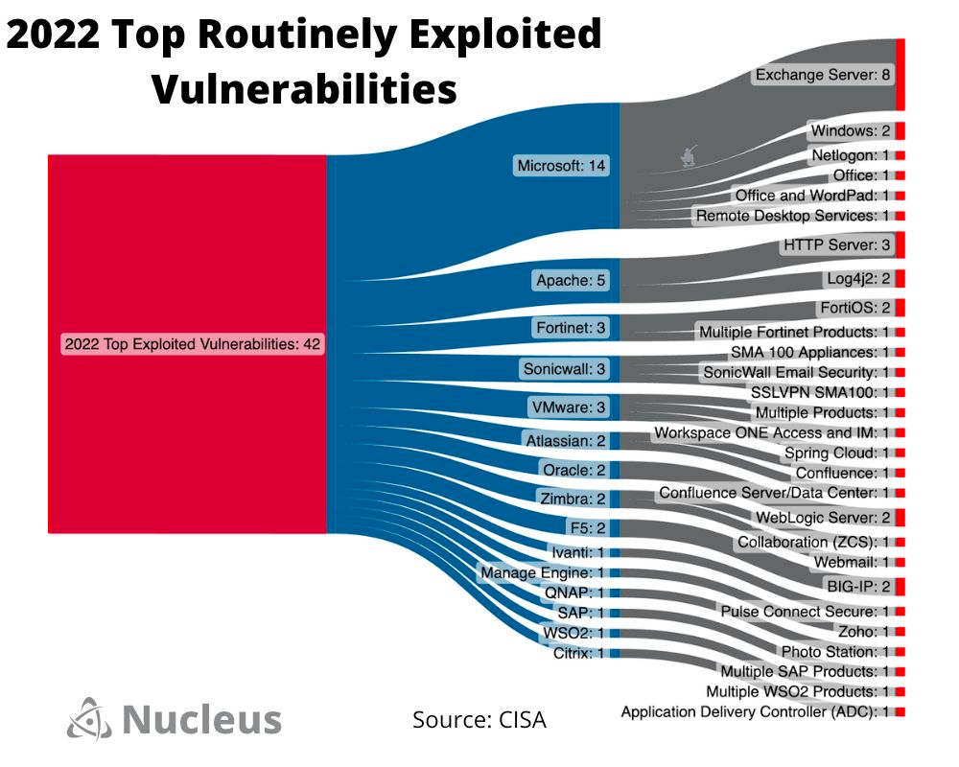
Created By: Patrick Garrity, Security Researcher, Nucleus Security
Created By: Patrick Garrity, Security Researcher, Nucleus Security
Notes:
Yesterday, the Cybersecurity and Infrastructure Security Agency, in collaboration with several international agencies, released a joint cybersecurity advisory regarding the "2022 Top Routinely Exploited Vulnerabilities."
The advisory highlighted that throughout 2022, malicious cyber actors demonstrated a higher frequency in exploiting older software vulnerabilities compared to recently disclosed ones. These actors predominantly targeted unpatched systems that were accessible via the internet. 🤦‍♂️
Given the challenges many organizations face in grasping the fundamentals of cybersecurity, I created a visualization of the vendors and products listed in the report.
If your systems happen to appear on this list, it is strongly recommended that you review CISA's report. Subsequently, conduct a thorough assessment of your systems' vulnerability status and implement necessary patches as appropriate. Additionally, I would like to emphasize that if you happen to identify any instances where these Common Vulnerabilities and Exposures (CVEs) have been exposed publicly, it might be prudent to initiate an investigation into the possibility of unauthorized access within your environment. Such occurrences could potentially indicate the presence of a malicious actors living off the land within your environment.
LinkedIn Post URL: https://www.linkedin.com/posts/patrickmgarrity_cybersecurity-infosecurity-riskmanagement-activity-7093190523393359872-7SWD?utm_source=share&utm_medium=member_desktop

Slide 6
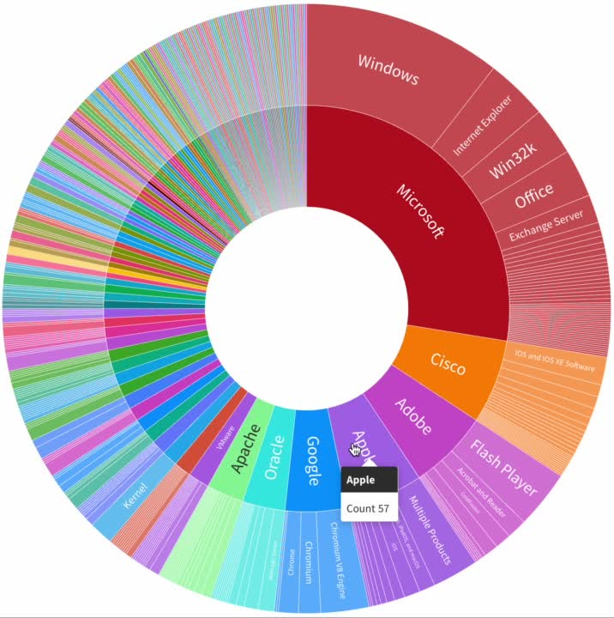
Interactive CISA KEV Vendor > Product Mapping to CVSS & EPSS
Created By: Patrick Garrity, Security Researcher, Nucleus Security
Notes:
The Cybersecurity and Infrastructure Security Agency Know Exploited Vulnerabilities (KEV) catalog now sits at 945 vulnerabilities and I've been continuing to explore new ways to sift through the list.
Building upon the work of my previous #KEV data visualizations, I'm excited to share a new example. This interactive version offers more detailed information including the ability to dive deeper into each vendor, product, and vulnerability. Watch as I simply click on a vulnerability to access details such as the Vendor, Product, CVE ID, CVSS score, and EPSS score.
I'm curious to find learn how data visualizations like these could impact the future of vulnerability management.
LinkedIn Post URL: https://www.linkedin.com/posts/patrickmgarrity_kev-cybersecurity-infosecurity-activity-7072342722837180416-x0eN?utm_source=share&utm_medium=member_desktop

Slide 7
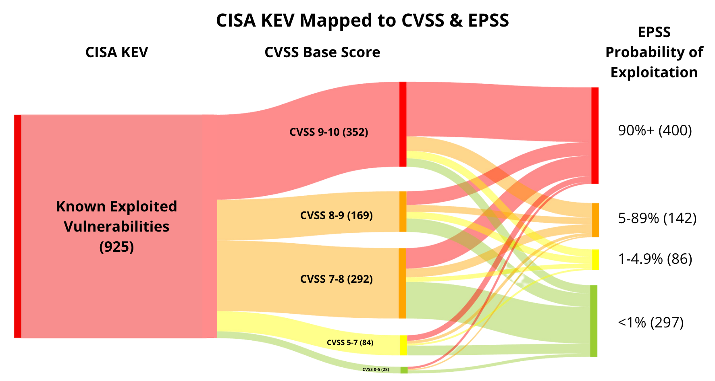
Created By: Patrick Garrity, Security Researcher, Nucleus Security
Notes:
When it comes to vulnerability management, security teams face a daunting challenge:
How to identify the vulnerabilities that pose the greatest #risk and prioritize them for remediation. For the last decade, most organizations relied on the Common Vulnerability Scoring System (#CVSS) to rank vulnerabilities by severity and still do. However, the exponential growth of vulnerabilities and exploitation in recent years has made this approach increasingly ineffective.
1️⃣ One of the core issues with using CVSS for prioritization is that it only considers the technical severity of a vulnerability, not risk, which often results in an overwhelming number of vulnerabilities to remediate. Furthermore, most of these vulnerabilities will likely never be exploited, making it difficult to know where to focus remediation efforts. As a result, many organizations feel like they are stuck in "vulnerability purgatory" with an unattainable backlog of vulnerabilities to address.
2️⃣ To address this challenge, alternative vulnerability prioritization methods have emerged that use vulnerability intelligence feeds such as Mandiant (now part of Google Cloud), Cybersecurity and Infrastructure Security Agency #KEV and FIRST's Exploit Prediction Scoring System (#EPSS) to identify high-risk vulnerabilities. These methods consider factors such as active exploitation, confirmed exploitation, and the probability of exploitation over the next 30 days.
3️⃣ To better understand how these different prioritization methods work, let's examine three of the most common methods: CISA's Known Exploited Vulnerability catalog, CVSS Base Score, and EPPS Probability of Exploitation. CISA's catalog provides a list of vulnerabilities that have been identified and confirmed to have been exploited in the wild. This list currently contains 925 vulnerabilities as of April. In contrast, CVSS ranks vulnerabilities on a scale of 0-10 based solely on technical severity. Organizations typically prioritize "critical" and "high" vulnerabilities, which are defined as having a CVSS score of 7 or higher. EPSS is a newer scoring methodology that prioritizes vulnerabilities based on their probability of exploitation over the next 30 days.
4️⃣ To illustrate the differences between these methods, we mapped CVSS and EPSS to the CISA KEV catalog of exploited vulnerabilities using the Nucleus Security CISA KEV enrichment dashboard. This exercise revealed that each prioritization method provides a unique perspective on which vulnerabilities should be remediated, emphasizing the importance of considering how vulnerability intelligence can be used. Using higher EPSS thresholds for instance is a good way to identify high risk vulnerabilities that haven’t been added to the #CISA KEV yet. It could also be useful in prioritizing the most critical exploited vulnerabilities if you have a pile of them.
#informationsecurity #riskmanagement #cybersecurity #security #intelligence #infosecurity #security #datasecurity
Linkedin URL Post: https://www.linkedin.com/posts/patrickmgarrity_risk-cvss-kev-activity-7062006464390828032-jl51?utm_source=share&utm_medium=member_desktop

Slide 8
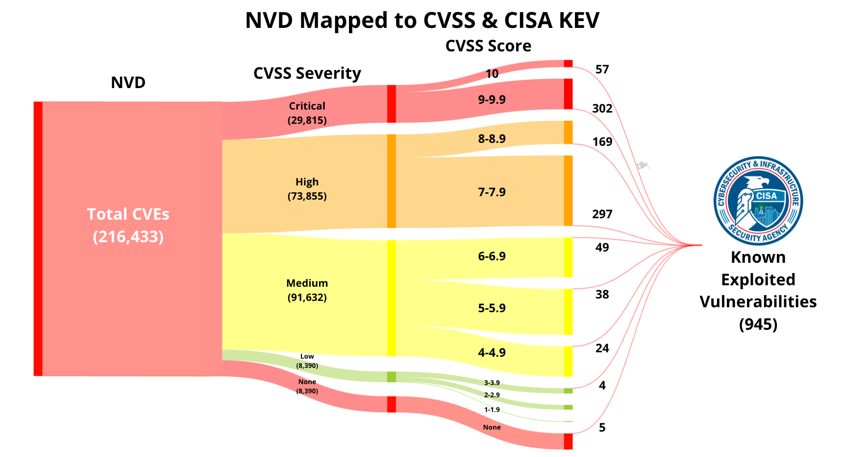
Created By: Patrick Garrity, Security Researcher, Nucleus Security
Notes:
In the realm of vulnerability management, the challenge of effectively prioritizing security efforts is an ongoing struggle for teams worldwide. Many organizations rely heavily on the Common Vulnerability Scoring System (CVSS) criticality and scoring as a primary means of assessing and addressing vulnerabilities. However, it's crucial to recognize the limitations of this approach and explore alternative methods for improved decision-making.
So I Leveraged the National Institute of Standards and Technology (NIST)'s National Vulnerability Database (NVD) and mapped it to CVSS severity, CVSS score ranges, and the Cybersecurity and Infrastructure Security Agency's known exploited vulnerabilities (KEV) catalog. The result? A Sankey Matic chart that visually portrays the vast landscape of known vulnerabilities and the challenges faced by security teams leveraging CVSS as their primary prioritization methodology.
One of the key takeaways from this analysis is that simply focusing on fixing CVSS 7+ (High and Critical) vulnerabilities, as often recommended in the industry, does not provide substantial value in terms of prioritization of work effort or coverage. In fact, this category still constitutes a significant majority of all Common Vulnerabilities and Exposures (CVEs), leaving teams overwhelmed by the sheer volume.
By mapping the data to the 945 exploited vulnerabilities identified by CISA KEV, it becomes evident that relying solely on CVSS to achieve similar prioritization results would require an insurmountable amount of work effort. This realization emphasizes the need to incorporate threat intelligence from sources like CISA KEV, Mandiant (now part of Google Cloud), GreyNoise Intelligence and others as the initial step in the prioritization process, even before considering traditional prioritization methods like CVSS. It's also worth considering the incorporation of Exploit Prediction Scoring System (EPSS) as an alternative to CVSS.
Furthermore, it is essential to factor in asset context along with vulnerability intelligence. Understanding the specific environment, system dependencies, and potential impact on critical assets provides a more comprehensive perspective for making informed decisions. By adopting a holistic approach that integrates threat intelligence and asset context, vulnerability management teams can elevate their effectiveness and proactively address the most critical security gaps.
https://www.linkedin.com/posts/patrickmgarrity_vulnerabilitymanagement-threatintelligence-activity-7073688679612887040-snaF?utm_source=share&utm_medium=member_desktop

Slide 9
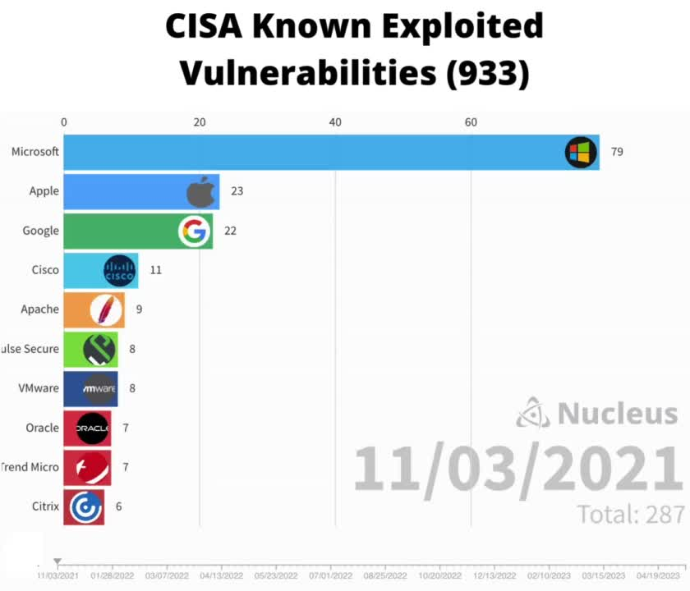
Created By: Patrick Garrity, Security Researcher, Nucleus Security
Notes:
The Cybersecurity and Infrastructure Security Agency (#CISA) KEV Catalog now lists 933 known exploited vulnerabilities. While this number may seem overwhelming, it's important to note that there are over 200,000 vulnerabilities now reported by National Institute of Standards and Technology (NIST) and MITRE.
After receiving positive feedback on the interactive prototype I dropped this week, I created another data visualization of the CISA KEV by vendor and the timeline of their addition to the list. This provides a better understanding of when vendor vulnerabilities were added to the list and how they stack rank against other vendors.
One significant finding that continues to stand out is the volume of exploited Microsoft vulnerabilities on the list, emphasizing the need for enterprise organizations to take patch Tuesday seriously and establish a strong process for identifying and remediating Microsoft vulnerabilities.
LinkedIn URL Post: https://www.linkedin.com/posts/patrickmgarrity_cisa-cisa-kev-activity-7063183449829883904-1ZxP?utm_source=share&utm_medium=member_desktop

Slide 10
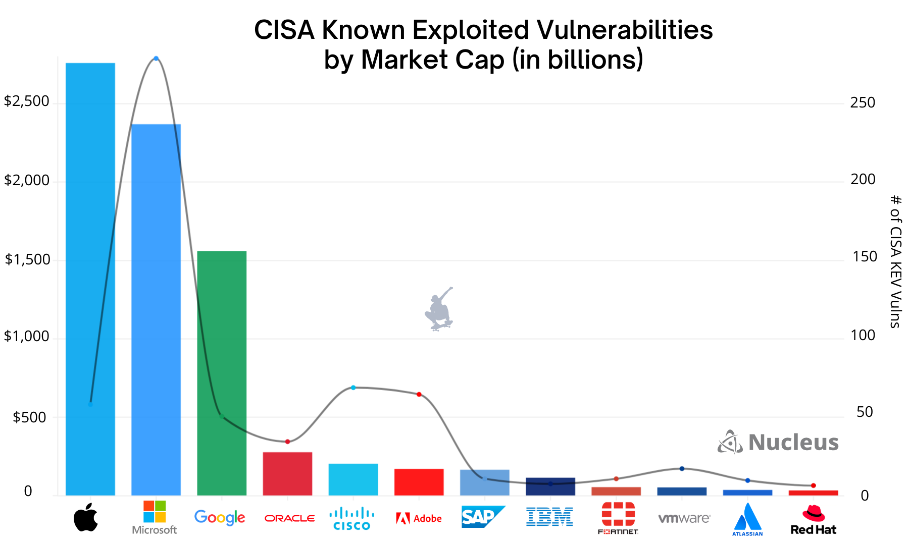
Created By: Patrick Garrity, Security Researcher, Nucleus Security
Notes:
As part of my research on the Cybersecurity and Infrastructure Security Agency's KEV catalog, a frequent request I've received was to explore the volume of vulnerabilities per vendor on the CISA KEV and their corresponding market capitalization.
Apple, Microsoft, Google, Oracle, Cisco, and other vendors included in the chart exhibit varying vulnerability counts. It's worth noting that this is not an exhaustive list but focuses on the top public companies with the most vulnerabilities on the CISA KEV list.
Vulnerability count: The trend line provides visibility into how the known exploited vulnerabilities are distributed among these vendors.
Market capitalization: The bar data shows the market capitalization of each vendor. By comparing this metric with the vulnerability count, we can identify any potential correlations or trends.
LinkedIn Post URL: https://www.linkedin.com/posts/patrickmgarrity_infosecurity-cybersecurity-riskmanagement-activity-7065724111603322880-Orsl?utm_source=share&utm_medium=member_desktop

Slide 11
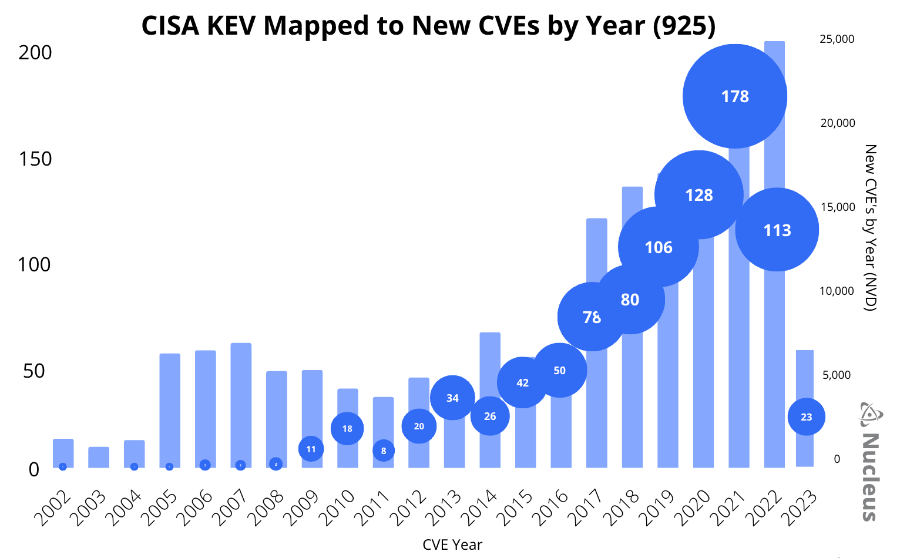
0
Created By: Patrick Garrity, Security Researcher, Nucleus Security
Notes:
In vulnerability management, context is key to determining what action to take. Useful context like knowing if a vulnerability is exploited is one of many data points to consider in determining risk.
Cybersecurity and Infrastructure Security Agency passed the Binding Operational Directive 22-01 in November 2021, creating the #CISA Known Exploited Vulnerability catalog and it's grown rapidly since. It now contains over 925 vulnerabilities.
We've received many questions about the CISA #KEV CVE's and have a desire ourselves to gain a better understanding of the context behind the vulnerabilities. One question we frequently get asked is about the age of the CVEs listed in the CISA KEV and how they map to the National Vulnerability Database maintained by National Institute of Standards and Technology (NIST).
To answer this question, we used the Nucleus Security CISA KEV enrichment dashboard to create a chart that shows the 925 CISA KEV vulnerabilities organized by the year the CVE was published.
From this data visualization, we observed several key trends:
➡ The majority of vulnerabilities weight to more recent years, which aligns with the accelerating growth of the NVD.
➡ Overall, the trend curve appears to align closely with yearly vulnerability disclosure.
➡ Data from 2022 and 2023 indicate a significant time delay between when a new CVE is identified, when exploitation occurs, and when CISA identifies and adds the vulnerability to the CISA #KEV. It would be interesting to research zerodays > KEV and Vulnerability time progression but I also assume someone like Mandiant (now part of Google Cloud) or Cyentia Institute might already have this research at their fingertips. (Add another research project to the list.)
➡ Vulnerability disclosure and exploitation continue to rise.
By understanding the trends within the CISA KEV, we can better contextualize and prioritize our vulnerability management efforts.
LinkedIn Post URL: https://www.linkedin.com/feed/update/urn:li:activity:7061744521167982593/?updateEntityUrn=urn%3Ali%3Afs_feedUpdate%3A%28V2%2Curn%3Ali%3Aactivity%3A7061744521167982593%29

Slide 12
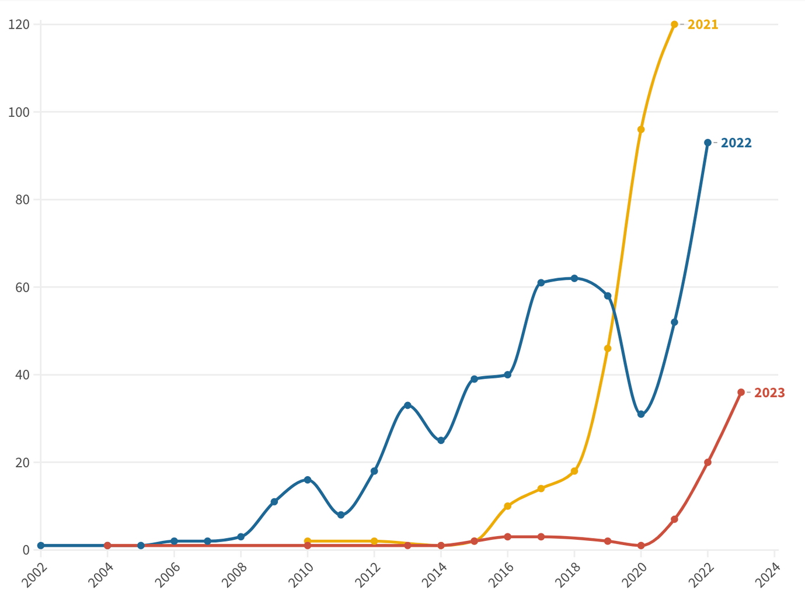


CISA KEV (YEAR ADDED TO KEV)
# of Vulnerabilities
CVE Year
Created By: Patrick Garrity, Security Researcher, Nucleus Security
Notes:
There has been ongoing debate surrounding the value of the Cybersecurity and Infrastructure Security Agency's (CISA) Known Exploited Vulnerabilities (KEV) Catalog within the security community. Hopefully this sheds some light on the significance of CISA KEV and should address some common concerns.
Outdated, Yet Not Irrelevant:
A recurring criticism of the CISA KEV catalog is the prevalence of old and seemingly obsolete vulnerabilities, with some dating as far back as 2002. However, it's important to note that outdated vulnerabilities still pose a considerable risk. Outdated technology continues to be pervasive in both the federal government and commercial enterprises, particularly in IoT, ICS, and OT environments. By addressing these known vulnerabilities, organizations can significantly reduce their risk exposure.
An Audit Function for Federal Agencies:
The CISA KEV catalog serves a vital purpose by requiring federal agencies to remediate vulnerabilities with confirmed exploitation. It acts as an audit function, ensuring timely remediation of exploited vulnerabilities. Furthermore, for a vulnerability to make it onto the CISA KEV, a patch or mitigation must be available. This requirement encourages agencies to actively seek and implement solutions to safeguard their systems.
The Timely Addition of New Zero-days:
Critics argue that the KEV catalog is slow to add new zero-day vulnerabilities. However, it's crucial to understand that the majority of exploitation activity, approximately 95%, targets vulnerabilities older than one year. It often takes years for an exploit to be developed and confirmed as being actively exploited. By prioritizing the remediation of known vulnerabilities, organizations can effectively bolster their security posture against the most prevalent threats. (If immediately responding to zero-days is important to your risk profile, I highly suggest considering incorporating a commercial vulnerability intelligence feed)
Addressing the Obscure:
Another concern raised about the CISA KEV catalog is the inclusion of vulnerabilities in obscure products. While these products may not be widely known, it's essential to recognize that they are often part of critical infrastructure or used by specific agencies or organizations. By capturing these vulnerabilities in the catalog, CISA ensures a comprehensive approach to helping secure critical infrastructure.
Before you worry too much about the next zero-day, I'd recommend doing a quick check to see if any vulnerabilities in your environment are on the CISA KEV and remediate them. All to often we find at Nucleus Security that known vulnerabilities with confirmed exploitation go overlooked and unpatched.
Linkedin Post URL: https://www.linkedin.com/posts/patrickmgarrity_cybersecurity-infosecurity-riskmanagement-activity-7077522867587846144-nzO7?utm_source=share&utm_medium=member_desktop

Slide 13
CISA Known Exploited Vulnerabilities by Vendor
Created By: Patrick Garrity, Security Researcher, Nucleus Security
Notes:
There are currently 925 known exploited vulnerabilities on Cybersecurity and Infrastructure Security Agency's KEV catalog, making it an excellent resource for identifying potential threats. With 156 vendors included, it's important to stay vigilant and prioritize remediation of vulnerabilities that have been identified as exploited to keep systems secure.
Microsoft is the leading vendor with over 258 vulnerabilities, underscoring the importance of staying on top of Patch Tuesday updates.
However, it's also important to recognize that just because a vulnerability has been exploited doesn't mean it's currently being targeted. To determine what vulnerabilities should be prioritized for remediation, it's critical to gain additional context beyond the #KEV. This includes vulnerability enrichment through sources such as #EPSS and Mandiant (now part of Google Cloud) and asset context, so you can make a risk-based decision on what vulnerabilities to fix first.
At Nucleus Security, we understand the importance of assessing vulnerability risk at scale. That's why our platform automates the aggregation and correlation of asset and vulnerability data, making it easier for organizations to make informed decisions about their cybersecurity posture.
LinkedIn Post URL:
https://www.linkedin.com/posts/patrickmgarrity_kev-epss-infosecurity-activity-7061037748832374785-IdQ5?utm_source=share&utm_medium=member_desktop

Slide 14
National
Vulnerability
Database
(NVD)

Slide 15
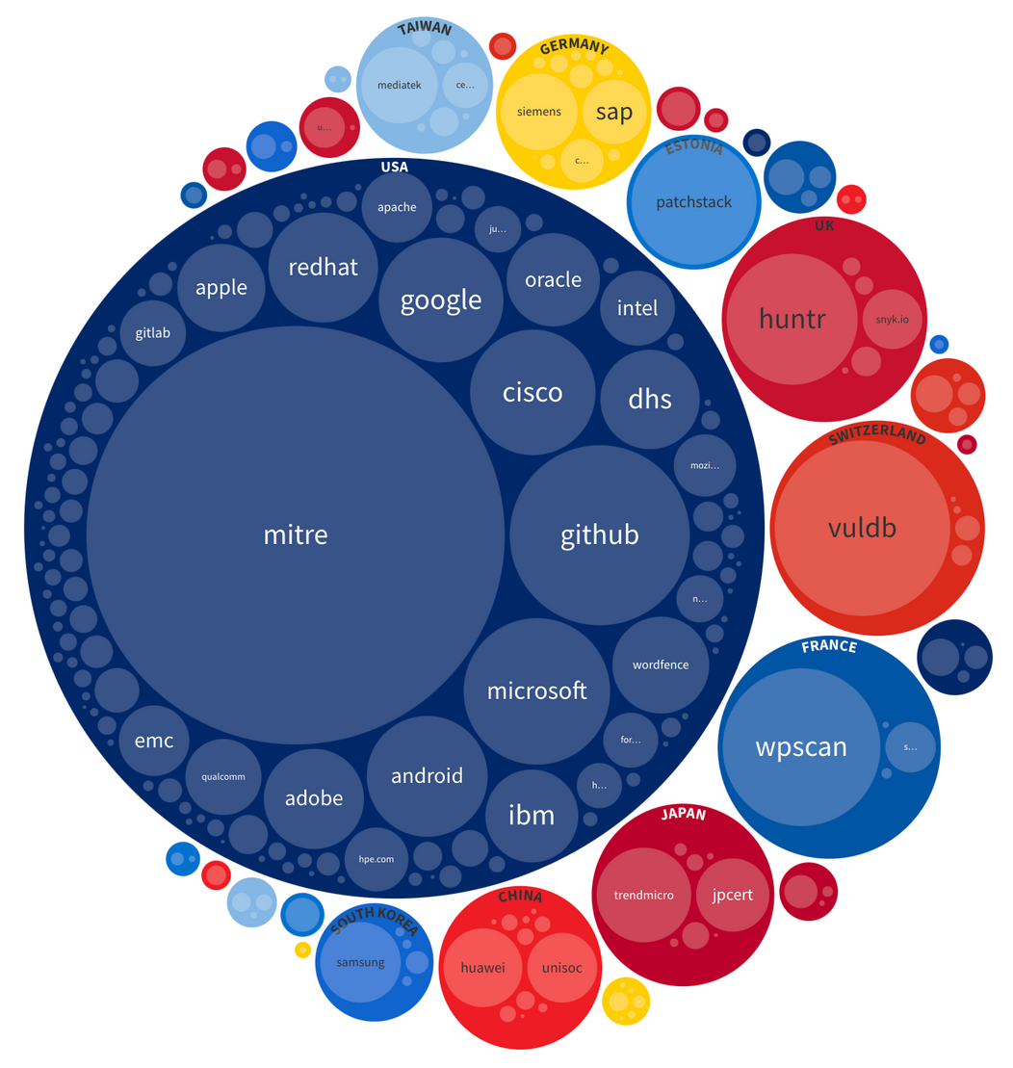
CVE Distribution by CVE Numbering Authority (2022-1H2023)
Created By: Patrick Garrity, Security Researcher, Nucleus Security
Notes:
Did you know there are 307 CNAs (CVE Numbering Authorities) from 36 countries participating in the creation of CVE's (Common Vulnerability Enumeration)?
Check out the chart I created that provides a look into the CVE distribution by CNA and Country they are located. The large majority of CNAs scope is focused on their own products.
Here are a few examples of CNAs and their scopes:
Microsoft's: Microsoft issues only
GitHub's: CVEs requested by software maintainers using the Github Security Advisories feature
MITRE: All vulnerabilities, and Open Source software product vulnerabilities, not already covered by a CNA listed on this website
Cisco: All Cisco products, and any third-party research targets that are not in another CNA’s scope
Once a CVE Record is published with details by the CNA, it will become available in the U.S. National Vulnerability Database (NVD). As one of the final steps in the process, Common Vulnerability Scoring System (CVSS) scores for the CVE Records are assigned by the NIST NVD team.
LinkedIn Post URL:
https://www.linkedin.com/posts/patrickmgarrity_vulnerabilitymanagement-nationalsecurity-activity-7089513441303953408-95Nw?utm_source=share&utm_medium=member_desktop

Slide 16

Created By: Patrick Garrity, Security Researcher, Nucleus Security
Notes:
Have you ever wondered why vulnerability management has become a pressing priority?
The answer lies in the combination of increased vulnerability exploitation as a primary attack vector and the exponential growth in the number of disclosed software vulnerabilities known as CVEs.
I’m sharing this animated chart I created that sheds light on the rising importance of investing in a building a strong vulnerability management program.
The chart showcases the escalating trend of published CVEs (Common Vulnerabilities and Exposures) each year by the CVE Program. It's evident that the number of vulnerabilities continues to grow, posing a significant challenge for vulnerability management teams.
With limited resources at hand, organizations face the challenge of managing the expanding vulnerability landscape effectively. Precision and velocity become crucial factors in making a meaningful impact. Efficient vulnerability management strategies such as incorporating threat and asset context must be implemented to address the ever-increasing number of vulnerabilities.
Additionally, I strongly believe that software vendors need to take more accountability in building secure software by design. Secure coding practices and a focus on developing robust software can help reduce the number of vulnerabilities, ultimately benefiting both vendors and end-users.
The combination of a proactive vulnerability management approach, precision in prioritization, and holding vendors accountable for software security are key elements in staying ahead of the evolving vulnerability & threat landscape.
LinkedIn Post URL: https://www.linkedin.com/feed/update/urn:li:activity:7083825990614843392/?updateEntityUrn=urn%3Ali%3Afs_feedUpdate%3A%28V2%2Curn%3Ali%3Aactivity%3A7083825990614843392%29

Slide 17
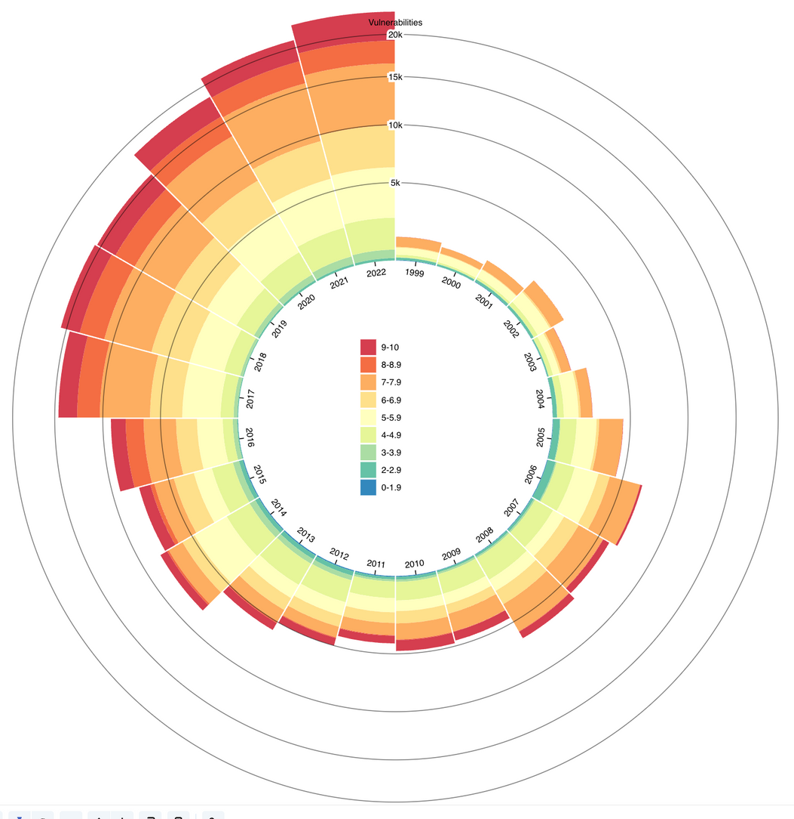
CVE Vulnerability Distribution Overtime by CVSS Score
CVSS Score
Created By: Patrick Garrity, Security Researcher, Nucleus Security
Notes:
Over the past two decades, the number of vulnerabilities being disclosed has grown exponentially. However, organizations have most often relied solely on the Common Vulnerability Scoring System's (CVSS) Base Score for prioritization which has proven to be ineffective. It's time for organizations to shift their approach and embrace a more comprehensive strategy for vulnerability management.
I've created this chart that illustrates the severity of the problem. With the exponential increase in vulnerabilities, it has become evident that we need to streamline vulnerability prioritization by considering contextual factors beyond the vulnerability itself.
To achieve a more effective impact in vulnerability management, organizations should consider the following critical steps:
➡️Automate Vulnerability Triage: Embrace frameworks like Stakeholder-Specific Vulnerability Categorization to automate the process of triaging vulnerabilities effectively.
➡️Leverage Broad Vulnerability Threat Intelligence: Incorporate valuable insights from sources like FIRST Exploit Prediction Scoring System(EPSS), Cybersecurity and Infrastructure Security Agency Known Exploited Vulnerabilities Catalog, Mandiant (now part of Google Cloud), Intel 471 and GreyNoise Intelligence. These sources provide rich threat intelligence that contributes to better prioritization.
➡️Factor in Business and Asset Context: To determine which vulnerabilities pose the highest risk to an organization, it is essential to consider the specific context of the business and its assets.
I'd enjoy hearing your thoughts on what steps your taking to get vulnerability management under control.
LinkedIn Post URL: https://www.linkedin.com/posts/patrickmgarrity_vulnerabilitymanagement-cybersecurity-dataprotection-activity-7091493749372981248-aBwd?utm_source=share&utm_medium=member_desktop

Slide 18
Exploit Prediction Scoring System
(EPSS)

Slide 19
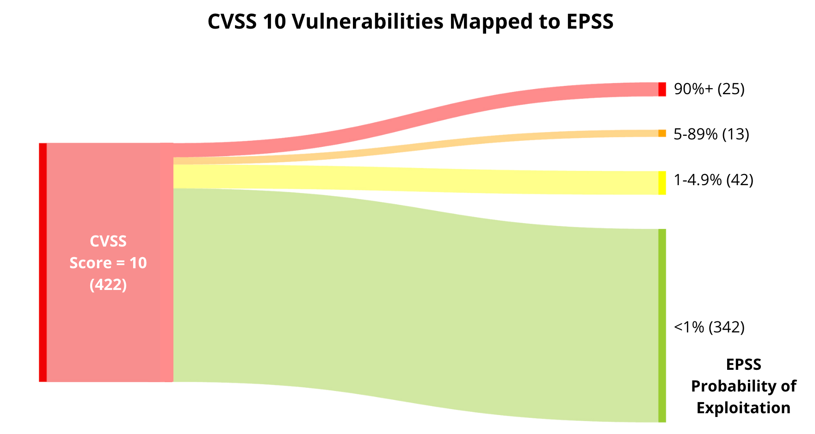
Created By: Patrick Garrity, Security Researcher, Nucleus Security
Notes:
Did you know that most organizations use an outdated method for prioritizing vulnerabilities? 🤔
While CVSS scores have been a popular metric for years, they may not provide the most accurate picture of a vulnerability's risk level. Enter EPSS – a scoring system that calculates the likelihood of a vulnerability being exploited in the next 30 days. 🔥
Out of 422 vulnerabilities with a CVSS score of 10, our data at Nucleus Security shows that only 38 have an EPSS probability score of 5% or higher. This means that the vast majority of these vulnerabilities are unlikely to be exploited in the near future.
But what does this mean for your organization? 🤷‍♂️
By using vulnerability intelligence like EPSS in addition to #CVSS, you can better prioritize your vulnerability triage and remediation efforts. Rather than focusing on vulnerabilities with the highest CVSS score, you can use EPSS to identify which vulnerabilities are most likely to be exploited and address them first.
So next time you're thinking about your organization's vulnerability management strategy, consider incorporating EPSS and other vulnerability intelligence feeds into your toolkit. 👍
LinkedIn Post URL: https://www.linkedin.com/posts/patrickmgarrity_cvss-epss-infosec-activity-7055915913623080960-AkIT?utm_source=share&utm_medium=member_desktop

Slide 20
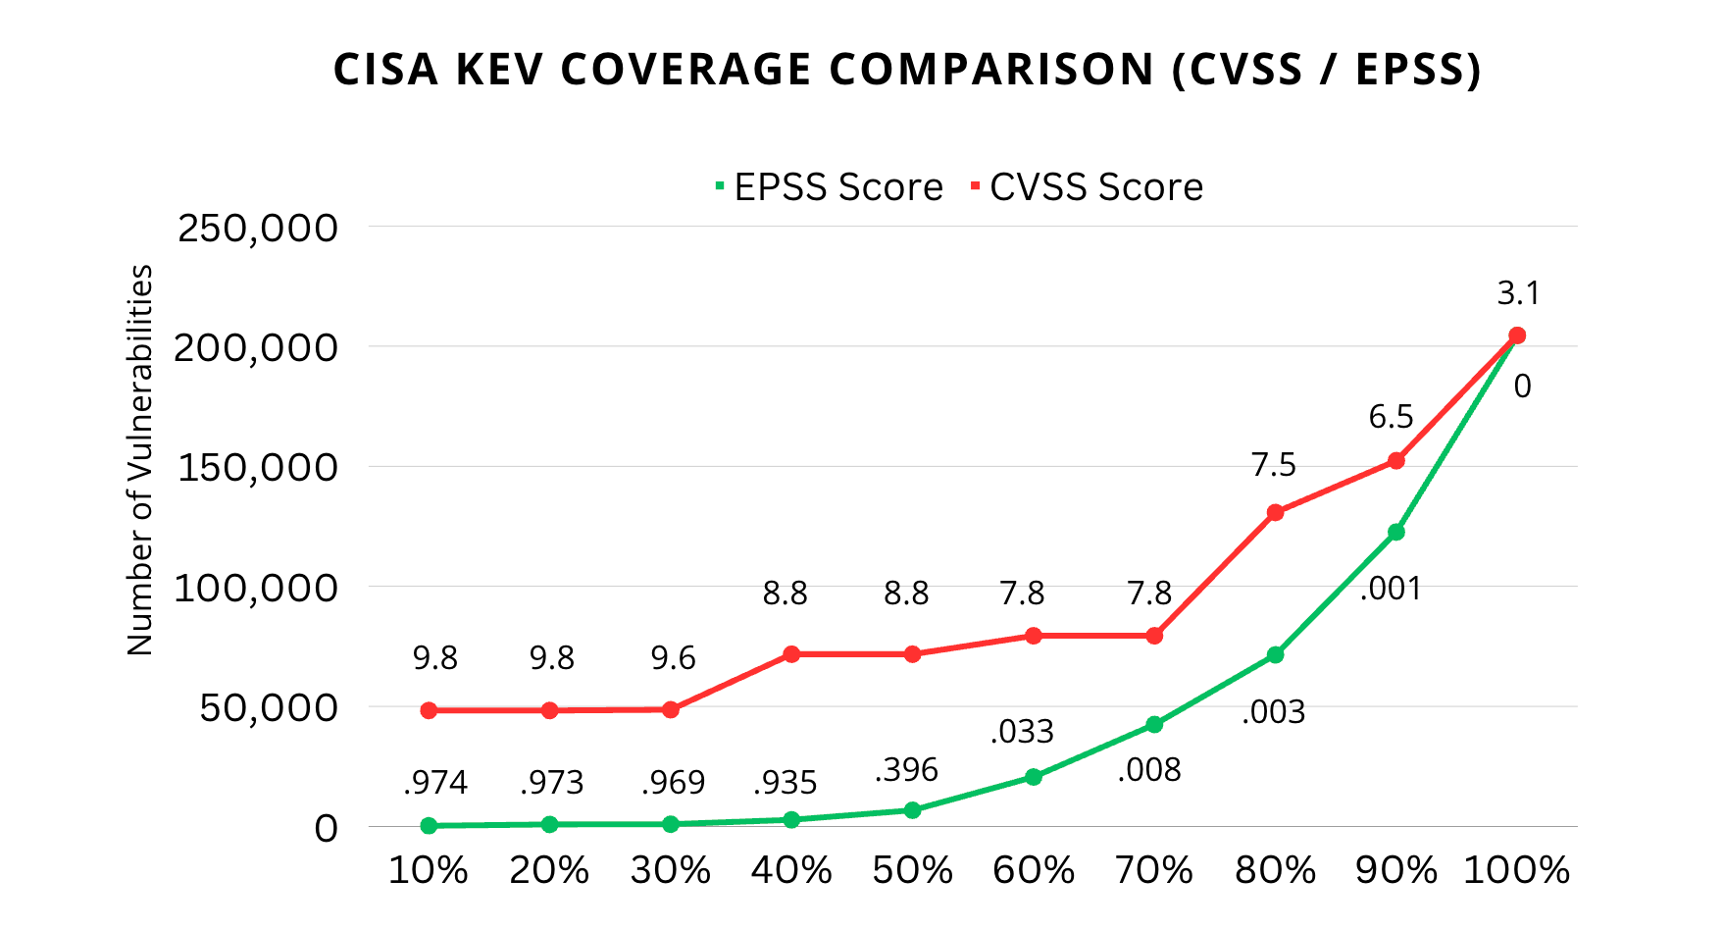
Created By: Patrick Garrity, Security Researcher, Nucleus Security
Notes:
When I first learned about EPSS as an alternative to CVSS, I was intrigued by its potential to drive more efficient results for enterprise vulnerability management programs.
However, upon reading the white paper for EPSS V3, it seemed almost too good to be true. Therefore, I decided to conduct my own research and evaluate EPSS against CVSS. To compare their real-world coverage of confirmed exploitation, I utilized the Cybersecurity and Infrastructure Security Agency's Known Exploited Vulnerabilities catalog.
The results clearly demonstrate that #EPSS V3 outperforms #CVSS V3.1, requiring significantly less effort to achieve the same coverage of CISA KEV vulnerabilities. It is important to note, however, that this data also underscores the need to supplement EPSS or CVSS with intelligence feeds like CISA KEV, Mandiant (now part of Google Cloud) and GreyNoise Intelligence that provide confirmed exploitation information.
Overall, EPSS shows promise as a valuable tool for enterprise organizations, but it should be used in conjunction with comprehensive intelligence feeds to ensure optimal vulnerability management prioritization.
LinkedIn Post URL: https://www.linkedin.com/posts/patrickmgarrity_epss-cvss-riskmanagement-activity-7072741416094859264-UTdF?utm_source=share&utm_medium=member_desktop

Slide 21
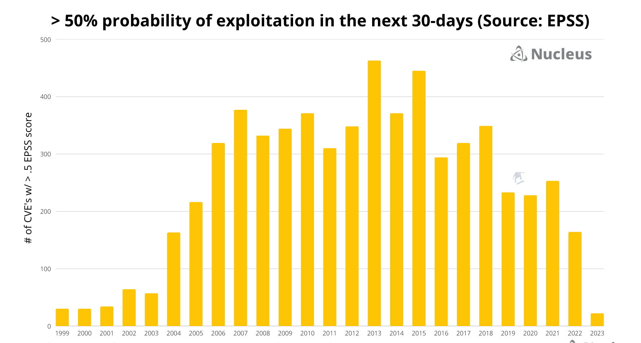
Created By: Patrick Garrity, Security Researcher, Nucleus Security
Notes:
Sharing a chart that outlines vulnerabilities with a high probability of exploitation over the next 30 days using the Exploit Prediction Scoring System(EPSS), categorized by the year each CVE was published.
The EPSS model reinforces a crucial point: the likelihood of being targeted by an unpatched vulnerability from previous years is significantly higher than being hit by a newly discovered zero-day exploit. While it's important to have a rapid response plan in place for new zero-days, it's important not to overlook the critical task of updating and patching older vulnerabilities that pose high risks.
Prioritize Patching: It's easy to get caught up in the excitement surrounding new zero-days, but maintaining a secure system means staying vigilant against known vulnerabilities. Our EPSS chart clearly demonstrates that unpatched vulnerabilities from past years continue to be a prevalent risk.
Comprehensive Security Strategy: Don't underestimate the impact of neglecting older vulnerabilities. Attackers are well aware of these existing weaknesses and are likely to exploit them. By proactively updating and patching, we reduce the chances of falling victim to known exploits.
Balancing Act: An effective security approach combines proactive measures (patching and updating) and reactive measures (responding to new zero-day vulnerabilities). Both aspects are crucial for mitigating risks and bolstering our overall security posture.
Remember, your organization's security is only as strong as its weakest link. By prioritizing the regular update and patching of older, higher-risk vulnerabilities, we reduce the likelihood of falling prey to known exploits, thus enhancing our overall defense against cyber threats.
LinkedIn Post URL: https://www.linkedin.com/posts/patrickmgarrity_cybersecurity-infosecurity-riskmanagement-activity-7083414503136112640-sPc3?utm_source=share&utm_medium=member_desktop

Slide 22
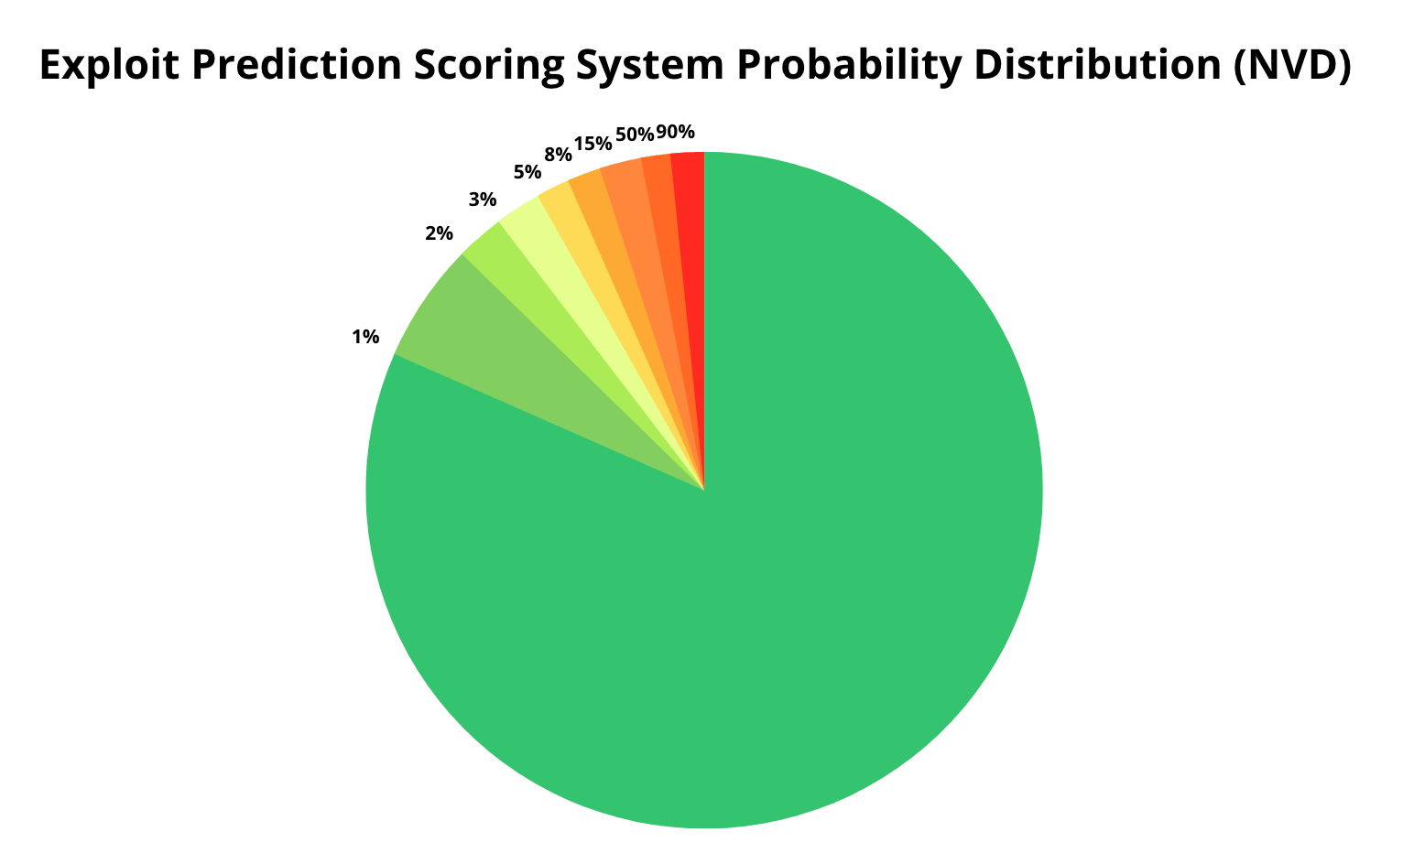
Created By: Patrick Garrity, Security Researcher, Nucleus Security
Notes:
It seems like everyone is talking about the FIRST Exploit Prediction Scoring System (EPSS) lately, and it's an important topic worth exploring.
To contribute to the conversation, I decided to create a diagram to complement the important discussion. The chart shows EPSS probability scoring distribution across the NVD. The probability demonstrates the likelihood a vulnerability is to be exploited in the next 30-days.
If you're interested in learning more about EPSS, I highly recommend checking out Chris Hughes 💭🔐 post. It provides a fantastic write-up on the benefits of using EPSS. You can find it here:
https://lnkd.in/gyvAewM6
LinkedIn Post URL: https://www.linkedin.com/posts/patrickmgarrity_vulnerabilitymanagement-riskmanagement-cybersecurity-activity-7091775220251836416-7lUJ?utm_source=share&utm_medium=member_desktop

Slide 23
Common Vulnerability Scoring System (CVSS)

Slide 24
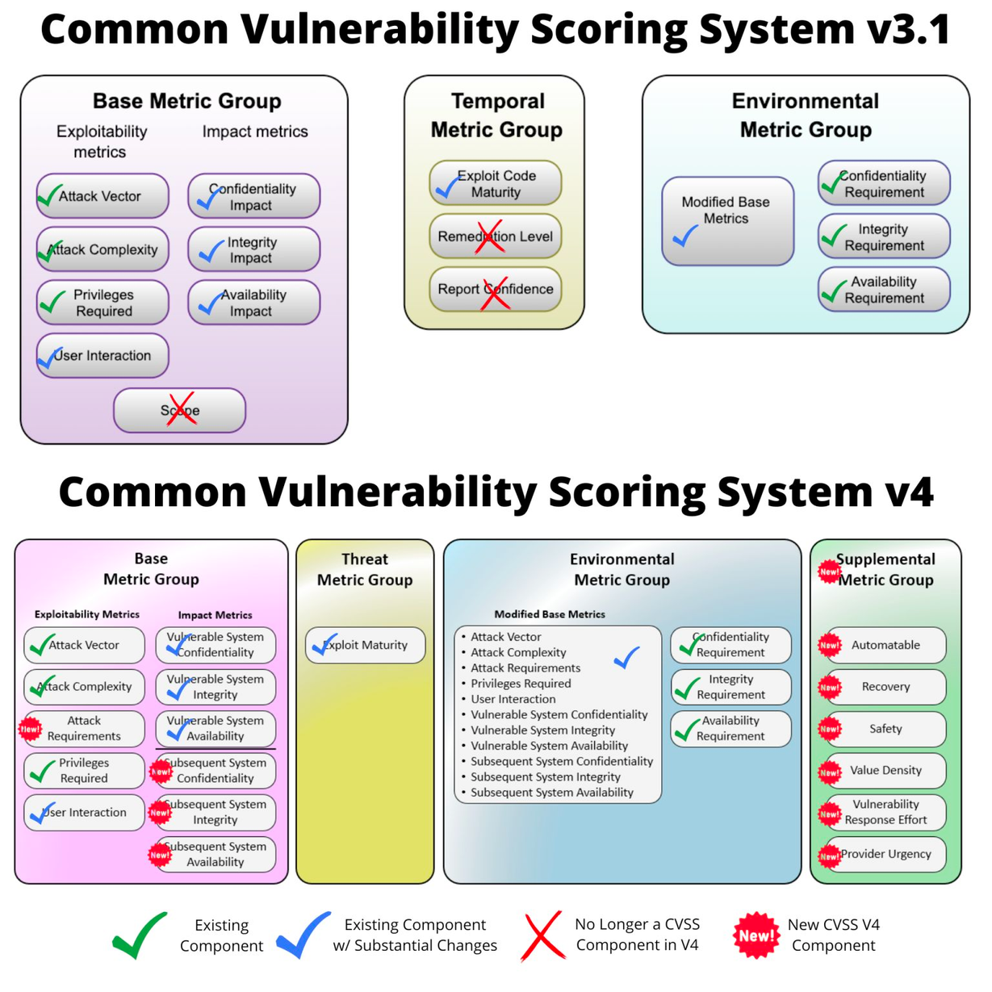
Created By: Patrick Garrity, Security Researcher, Nucleus Security
Notes:
Today, FIRST has announced the public preview of CVSS V4.0, and it's now open for feedback. This release brings some exciting changes. To help you understand the differences between CVSS V3.1 and V4.0, I have created a visualization that compares the two versions metrics.
Personally, I'm intrigued by how the new scoring methodology in CVSS V4.0 will enhance vulnerability analysis. It has the potential to provide vulnerability analysts with more effective scoring, addressing the historical shortcomings of CVSS. This could potentially lead to better assessments of the impact of vulnerabilities. However, we should remain cautiously optimistic until the scoring itself demonstrates significant improvements.
The changes in metrics are complex and require careful consideration. Even I find myself overwhelmed by the details. In short, it's a lot to digest!
CVSS V4.0 Public Prevew is now live here: https://lnkd.in/gC3uDUKv
Now, I'd love to hear your thoughts on areas where CVSS could be further improved. What aspects of this important framework do you believe require enhancement?
LinkedIn Post URL:

Slide 25
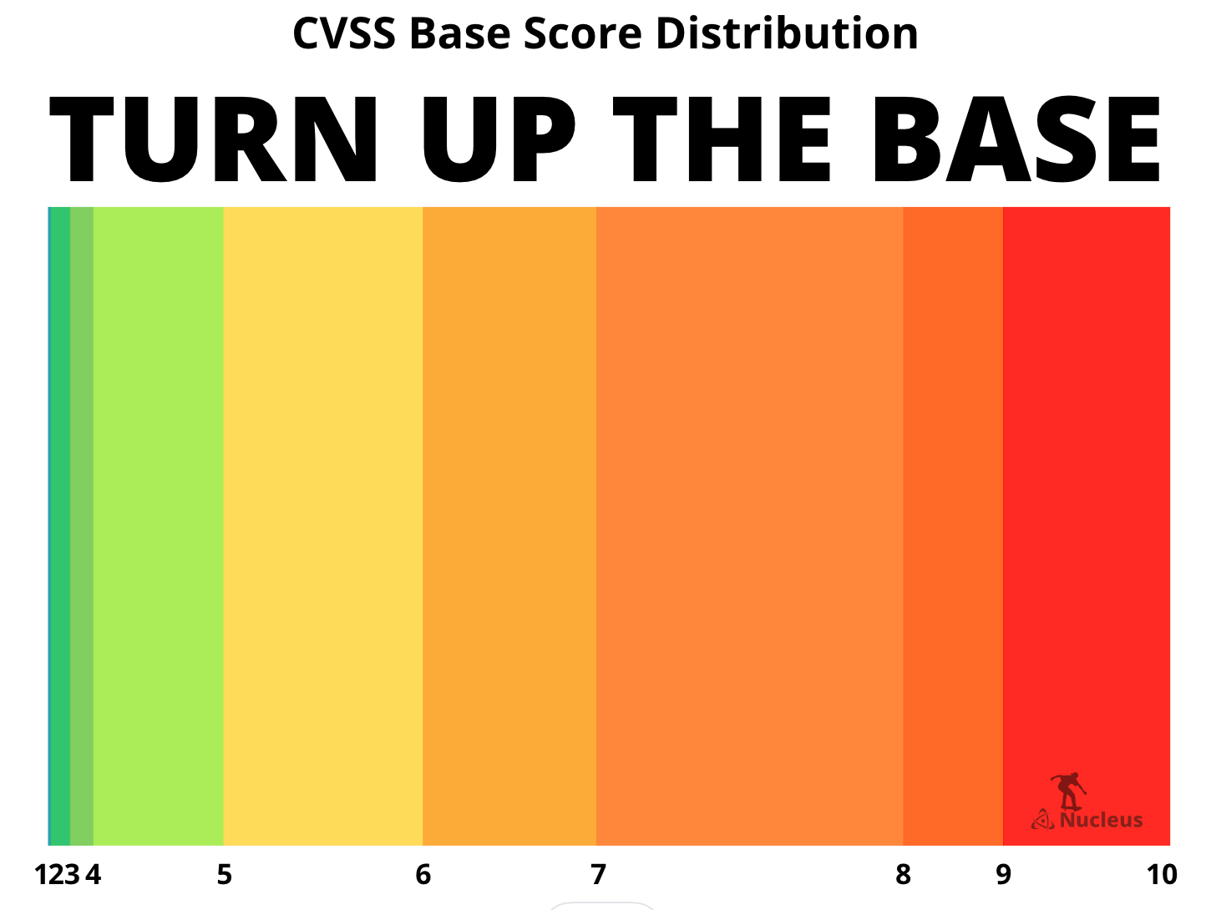
Created By: Patrick Garrity, Security Researcher, Nucleus Security
Notes:
The Common Vulnerability Scoring System (CVSS) base score is widely used by vulnerability management teams to assess vulnerabilities.
During my research on CVSS and FIRST's public preview of V4, I discovered that there is a high probability of CVSS base scores increasing with CVSS V4. This inspired me to create a data visualization depicting the distribution of current CVSS base scores as a percentage of vulnerabilities in the National Institute of Standards and Technology (NIST) National Vulnerability Database.
CVSS is about to "TURN UP THE BASE"!
This visualization emphasizes the importance of vulnerability management programs incorporating asset and threat context to better evaluate vulnerability risks within their specific environments as CVSS scores continue to soar.
What's exciting is that CVSS's new nomenclatures go beyond the base score by including threat and environmental context. This has the potential to benefit organizations with the resources to enhance CVSS, as these additional metrics are required for each organization choosing to use them. Nucleus Security is well-positioned to help automate the implementation of these new nomenclatures with threat intelligence already integrated from Mandiant (now part of Google Cloud) and the Cybersecurity and Infrastructure Security Agency's Known Exploited Vulnerability catalog, once CVSS V4 is officially released.
There are also promising alternatives to CVSS, many of which rely on CVSS metrics in their approach:
1. The Exploit Prediction Scoring System (EPSS) uses threat intelligence to predict the probability of a vulnerability being exploited within the next 30 days.
2. Stakeholder-Specific Vulnerability Categorization employs logic-based decisions to prioritize vulnerability remediation.
3. Commercial Threat Intelligence Risk Scoring.
These approaches can complement each other effectively, if you're interested in learning about how, I would recommend checking out Chris Madden's implementation of SSVC which he published on Github.
#riskmanagement #infosecurity #cybersecurity #security #vulnerabilitymanagement #cvss #ciso #infosecurity
LinkedIn Post URL: https://www.linkedin.com/posts/patrickmgarrity_riskmanagement-infosecurity-cybersecurity-activity-7084191428951633920-wBY-?utm_source=share&utm_medium=member_desktop

Slide 26
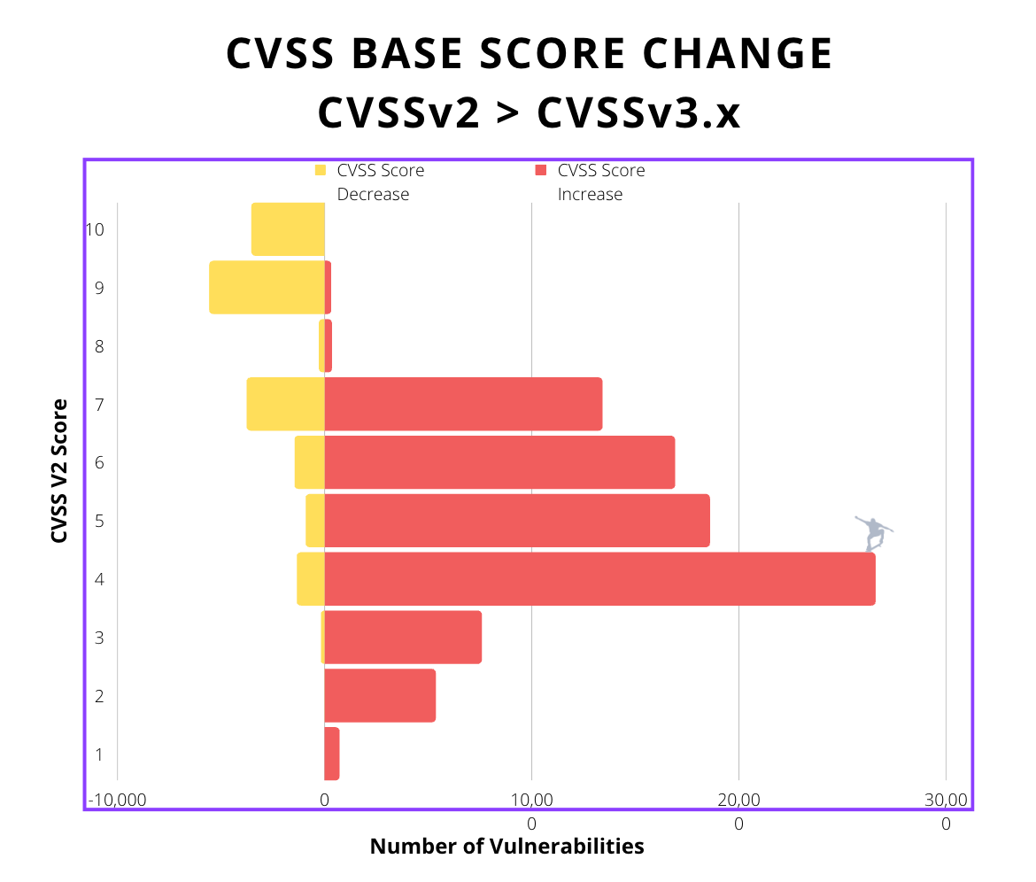
Created By: Patrick Garrity, Security Researcher, Nucleus Security
Notes:
As I continue to dive into the proposed changes of FIRST CVSS v4 and their potential impact on the scoring landscape, it's crucial to reflect on the historical scoring transitions from CVSSv2 to CVSSv3.x.
During my analysis, I've been observing a consistent trend that vulnerability management teams have experienced—a significant number of vulnerabilities being scored as critical or high. This led me to investigate the impact of FIRST CVSS's update from CVSSv2 to CVSSv3. The chart I created vividly illustrates the significant influence of this CVSS update. It showcases how a vast majority of vulnerabilities that were reassessed, resulted in an increase in their base score.
Building upon this foundation, I'm continuing my analysis of CVSSv4. So far I anticipate a significant probability of a redistribution in the CVSS base score due to substantial changes in key variables. These changes include the removal of the scope metric, the introduction of attack requirements and subsequent system metrics, and the application of new mathematical principles. Consequently, we can expect a broader distribution of CVSS scoring from V3 to V4.
This emphasizes the importance of not relying solely on vulnerability scoring systems and considering additional attributes, aligning with the advice provided by the CVSS working group:
"CVSS Base scores (CVSS-B) represent Technical Severity and only takes into consideration the attributes of the vulnerability itself. It is not recommended to use this alone to determine remediation priority."
To effectively assess and prioritize risk, it is critical to incorporate additional context, including threat intelligence and asset context. Some of which could be addressed with the threat and supplemental factors which reflect the CVSS BTE scoring which I'll dive into soon.
LinkedIn Post URL: https://www.linkedin.com/posts/patrickmgarrity_riskmanagement-cvss-infosecurity-activity-7074804470043316224-vkoU?utm_source=share&utm_medium=member_desktop

Slide 27
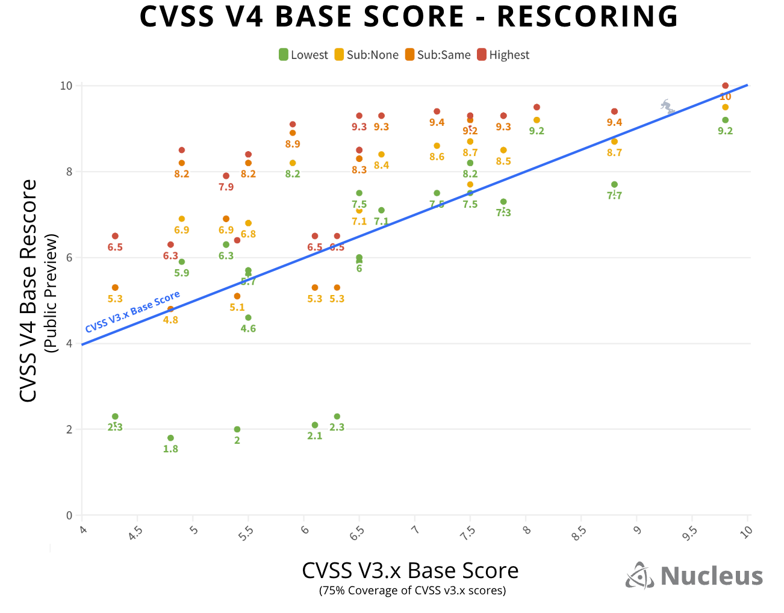
Created By: Patrick Garrity, Security Researcher, Nucleus Security
Notes:
Here are my findings on the base scoring impact of the upcoming release of FIRST Common Vulnerability Scoring System (CVSS) v4 which is currently in public preview...
It's worth noting that CVSS base scoring has been the most widely adopted vulnerability scoring system in the world. This score is published into the National Vulnerability Database and populates into most vulnerability management tools.
In my research, I took the initiative to rescore CVSS v3 and v3.1 base score strings using the new CVSS v4 calculator. Out of all vulnerabilities with a CVSS score of v3 and v3.1, I was able to rescore 75%. The rescoring required a range of possible scores to incorporate the possibilities of the changes of existing attributes.
The results, showcased in the chart I created, indicate a high likelihood of an overall increase in CVSS scores. This brings attention to the importance of considering threat intelligence sources like EPSS, Cybersecurity and Infrastructure Security Agency know exploited vulnerabilities catalog, and epss, and asset context when using CVSS base scoring for vulnerability prioritization.
While CVSS Base scores (CVSS-B) provide a measure of "Technical Severity" by focusing solely on the attributes of the vulnerability itself, it is crucial to note that it is not recommended to rely on the CVSS base score alone for determining remediation priority.
As we anticipate the release of CVSS v4, it becomes evident for those using CVSS that asset context and additional factors will play an increasingly important role in making informed decisions about which vulnerabilities to prioritize.
It's worth noting that this work was a best effort and there are other possible scoring outcomes that may not be reflected in the chart. For example I did not calculate the score of a vulnerability that would only impact the subsequent system and not the vulnerable system. 🖖
LinkedIn Post URL: https://www.linkedin.com/posts/patrickmgarrity_riskmanagement-vulnerabilitymanagement-cvss-activity-7076951844199047168-V0tx?utm_source=share&utm_medium=member_desktop

Slide 28
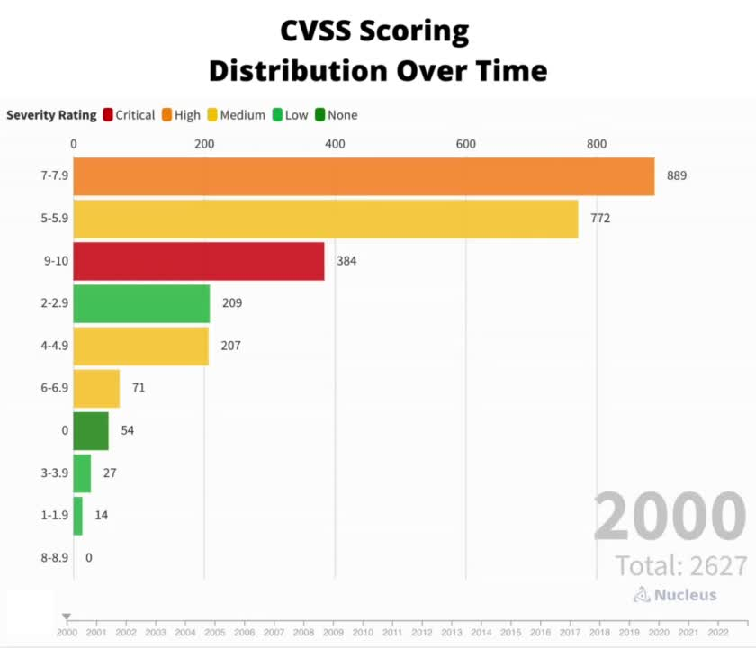
Created By: Patrick Garrity, Security Researcher, Nucleus Security
Notes:
As I dive into the changes proposed for FIRST CVSS in the V4 public preview, I've been examining the historical base score distribution over time to understand the impacts of previous CVSS version changes.
Here are a few key observations:
1. Watching CVSS score distribution over time is a lot like watching paint dry. This should be expected out of a relatively static scoring system.
2. The CVSS score range 7-7.9 has consistently been the top range over the past 20+ years, followed closely by 5-5.9.
3. In 2015, with the adoption of CVSS V3.1, a notable change occurred. There was a substantial increase in vulnerabilities scoring in the 8-8.9 range. My understanding from recent Cyentia Institute research is that the scores increased in average by +1.
CVSS V3.1 brought several changes to the scoring methodology. It introduced the concept of "Scope" to handle vulnerabilities that exist in one component but impact another. It also updated terms from "Access" to "Attack" and introduced the factors of "Privileges Required" and resolved the issue of Partial impact by introducing Low/High distinctions.
It's worth noting that CVSS V4.0 is currently in the public preview phase, and its proposed changes are expected to have a further impact on the base score distribution. One of the goals of V4.0 is to provide finer granularity, which should reflect in the score distribution.
Analyzing the historical base score distribution over time helps us understand the evolution of CVSS scoring and the potential effects of version changes. As CVSS V4.0 progresses, we are hopeful of a more refined scoring system that captures vulnerability severity with greater precision.
LinkedIn Post URL: https://www.linkedin.com/posts/patrickmgarrity_riskmanagement-cvss-securityoperations-activity-7074120712654913536-OwkO?utm_source=share&utm_medium=member_desktop

Slide 29









Just Another Day in Vulnerability Management
CVSS 4-4.9
(23,760)
Vulnerability Exploitation
CVSS 5-5.9
(35,945)
CVSS 3-3.9
(4,111)
CVSS 2-2.9
(3,684)
CVSS 6-6.9
(31,267)
557
CVSS 7.7.9
(55,187)
CVSS 8-8.9
(18,041)
CVSS 9-9.9
(23,939)
CVSS 10
(5,692)
Created By: Patrick Garrity, Security Researcher, Nucleus Security
Notes:
Vulnerability management is undeniably one of the most challenging tasks in the field of cybersecurity.
1. Enterprise Vulnerability Management teams primarily responsibility is coordination across IT and development teams to help them understand which vulnerabilities are the highest risk and need to be remediated.
2. In today's landscape of increasing assets and vulnerabilities, relying solely on scanner outputs exported to Excel is no longer scalable.
3. Outdated policies mandating ineffective prioritization standards like CVSS contribute to a mountain of vulnerability debt.
In the accompanying image, I portray the vulnerability management team persistently pushing CVSS score boulders up the mountain of vulnerability debt. The size of the boulder represents the volume of CVEs on the NVD by CVSS score. Chaos ensues with the continuous onslaught of exploitation attempts represented by thunderbolts striking down on the vulnerability analyst. This illustration perfectly captures the daunting nature of their task.
LinkedIn Post URL: https://www.linkedin.com/posts/patrickmgarrity_infosecurity-cybersecurity-riskmanagement-activity-7064622860337565698-v-nb?utm_source=share&utm_medium=member_desktop

Slide 30
Stakeholder Specific Vulnerability Categorization (SSVC)

Slide 31
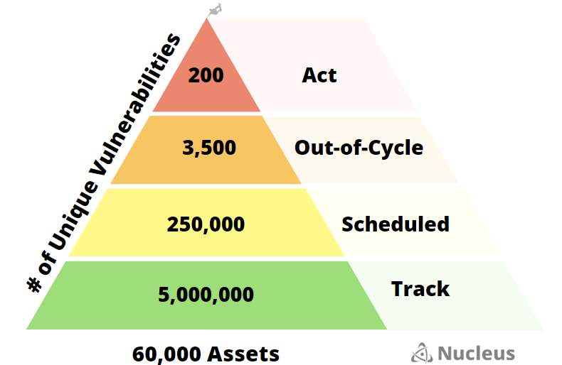
SSVC Vulnerability Prioritization Pyramid
Created By: Patrick Garrity, Security Researcher, Nucleus Security
Notes:
I'm excited to share a draft guide on automating vulnerability prioritization using decision trees aligned with Stakeholder-Specific Vulnerability Categorization (SSVC) and I’m interested in your feedback.
This guide provides an approachable framework for automating vulnerability prioritization, ensuring scalability and adoption of SSVC decision tree-based logic. SSVC was created by security researchers at Software Engineering Institute | Carnegie Mellon University and has been adopted by Cybersecurity and Infrastructure Security Agency.
The key topics in the guide cover:
- An Introduction to Stakeholder-Specific Vulnerability Categorization (SSVC)
- Dependencies for Automating Vulnerability Prioritization Using Decision Trees
- Outlining Decision Outcomes and Criteria
- Visualizing the Vulnerability Prioritization Decision Tree
- Building Decision Tree Rules for Automation
- Defining Vulnerability Intelligence & Asset Metrics for Automation
- Modeling Vulnerability Decision Tree Outcomes with SSVC
Your feedback on this guide is highly appreciated as we refine it further. A special thanks to those who already provided valuable feedback during the creation of this guide. This guide is not necessarily a representation of their opinion or views.
LinkIn Post URL: https://www.linkedin.com/posts/patrickmgarrity_a-guide-to-automating-vulnerability-prioritization-activity-7087527275583205376-fobq?utm_source=share&utm_medium=member_desktop

Slide 32
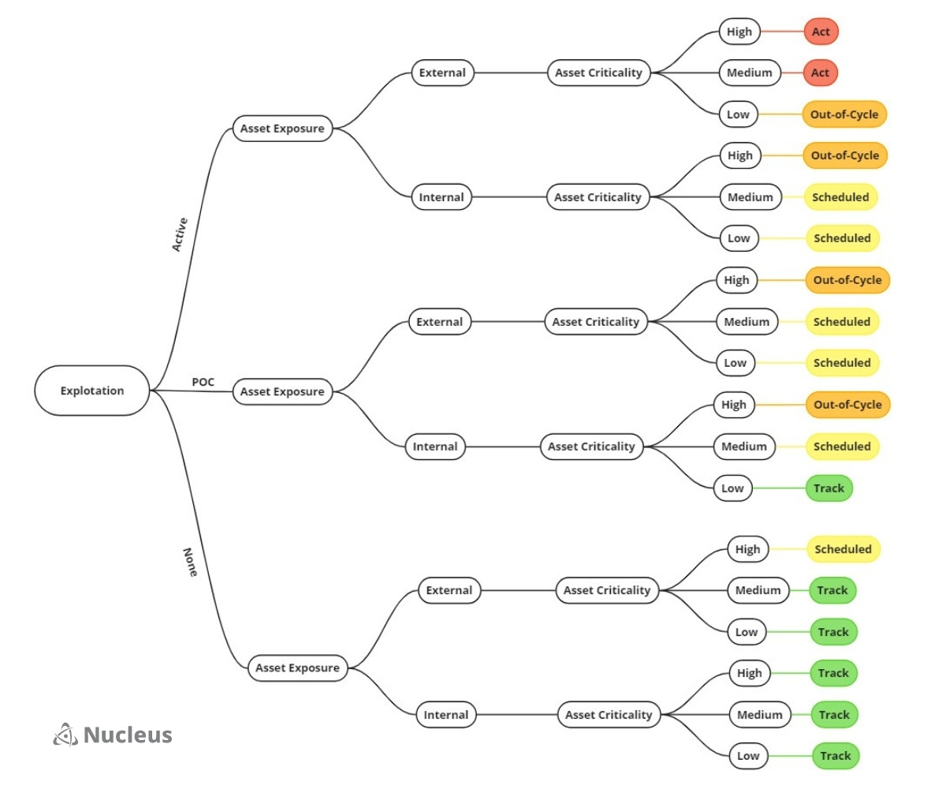
SSVC Decision Tree Example
Created By: Patrick Garrity, Security Researcher, Nucleus Security
Notes:
I'm excited to share a draft guide on automating vulnerability prioritization using decision trees aligned with Stakeholder-Specific Vulnerability Categorization (SSVC) and I’m interested in your feedback.
This guide provides an approachable framework for automating vulnerability prioritization, ensuring scalability and adoption of SSVC decision tree-based logic. SSVC was created by security researchers at Software Engineering Institute | Carnegie Mellon University and has been adopted by Cybersecurity and Infrastructure Security Agency.
The key topics in the guide cover:
- An Introduction to Stakeholder-Specific Vulnerability Categorization (SSVC)
- Dependencies for Automating Vulnerability Prioritization Using Decision Trees
- Outlining Decision Outcomes and Criteria
- Visualizing the Vulnerability Prioritization Decision Tree
- Building Decision Tree Rules for Automation
- Defining Vulnerability Intelligence & Asset Metrics for Automation
- Modeling Vulnerability Decision Tree Outcomes with SSVC
Your feedback on this guide is highly appreciated as we refine it further. A special thanks to those who already provided valuable feedback during the creation of this guide. This guide is not necessarily a representation of their opinion or views.
LinkIn Post URL: https://www.linkedin.com/posts/patrickmgarrity_a-guide-to-automating-vulnerability-prioritization-activity-7087527275583205376-fobq?utm_source=share&utm_medium=member_desktop

Slide 33
GreyNoise

Slide 34

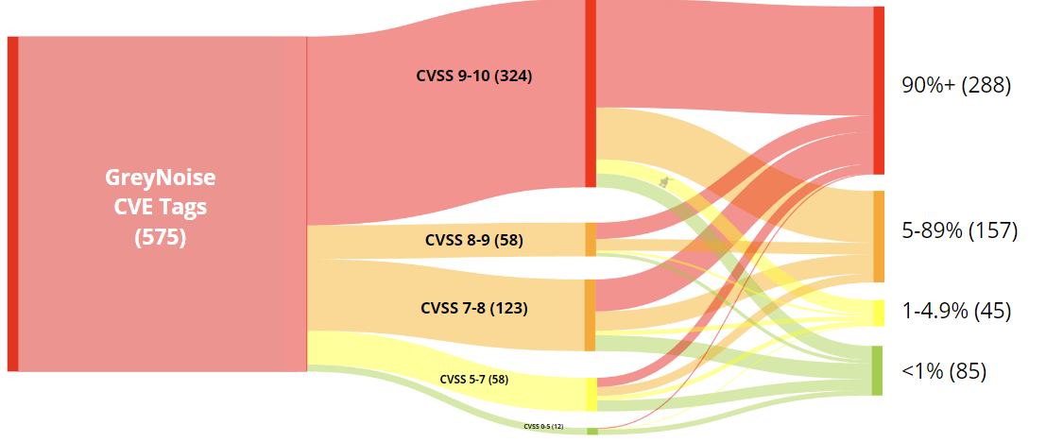
GreyNoise Mapped to CVSS & EPSS
EPSS
Probability of Exploitation
CVSS Base Score
Created By: Patrick Garrity, Security Researcher, Nucleus Security
Notes:
Earlier this year, I explored the correlation between CVSS and EPSS scoring systems and vulnerabilities confirmed as exploited by the Cybersecurity and Infrastructure Security Agency (CISA).
This week, I took a similar approach and analyzed GreyNoise Intelligence CVE tags. For context, GreyNoise's honeypot network actively monitors and adds tags to vulnerabilities that are highly likely to have been or are currently being exploited in the wild. Most of them happen to be Remote Code Execution vulnerabilities.
GreyNoise's discovery phase involves monitoring various sources, including tech news outlets, social media, CISA's Known Exploited Vulnerabilities Catalog, and customer/community requests. Their researchers identify and prioritize CVEs that hold significance due to their scale, targeted appliances, and more.
The GreyNoise tags are valuable to consider for prioritization, as any vulnerability with a GreyNoise tag has a high likelihood of having been exploited at some point. Interestingly, the mapping of these vulnerabilities to scoring systems, such as CVSS and EPSS, highlights instances where vulnerabilities on the list have low scores. This underscores the critical need to incorporate broad threat intelligence into your vulnerability management program to enhance visibility into exploitation.
Linkedin Post URL: https://www.linkedin.com/feed/update/urn:li:activity:7087527275583205376/?updateEntityUrn=urn%3Ali%3Afs_feedUpdate%3A%28V2%2Curn%3Ali%3Aactivity%3A7087527275583205376%29

Slide 35
Zero Days

Slide 36
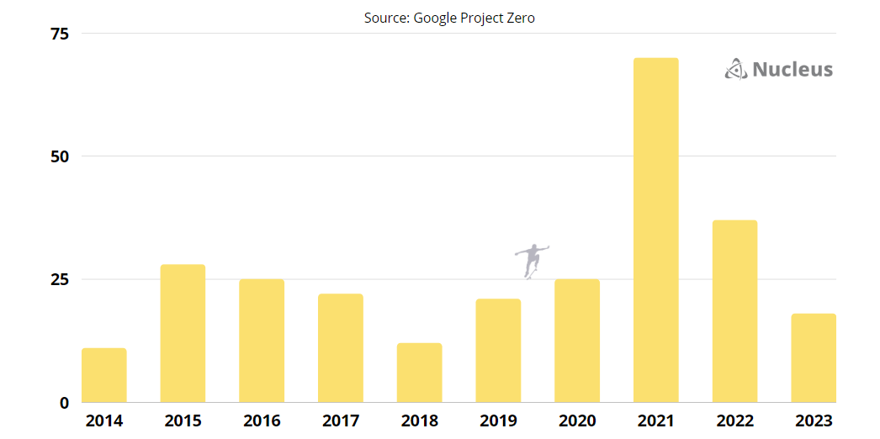
Zero-Day Vulnerabilities by Year (269)
Created By: Patrick Garrity, Security Researcher, Nucleus Security
Notes:
Zero-Day Vulnerabilities have been a hot topic of discussion over the last decade. Media coverage often amplifies these vulnerabilities, contributing to a cascading effect that puts IT and security teams into a scramble to understand the potential impact on their environment, and at times for good reason.
Google's Project Zero has been diligently tracking publicly known zero-day exploits and has captured 269 of them over the past decade. This comprehensive list provides valuable insights. To put it into perspective, these 269 vulnerabilities account for only 0.125% of the total number of vulnerabilities in the National Vulnerability Database (NVD).
Digging deeper into the data, Google found that, on average, a new zero-day exploit 'in the wild' is discovered every 17 days. It's worth noting that these discoveries often clump together in exploit chains, meaning multiple vulnerabilities are found and disclosed simultaneously. We saw this just last week when Apple disclosed 3 zero-day vulnerabilities.
Furthermore, Google found that it takes an average of 15 days for vendors to patch actively exploited vulnerabilities that are currently under attack. This emphasizes the need for a swift response from organizations to secure their systems.
Additionally, it is noteworthy that memory corruption issues contribute to 68% of the listed CVEs.
Considering the consistent flow of zero-day vulnerabilities, it is important for organizations to establish a pro-active rapid vulnerability response plan for not only zero-days but all high-risk vulnerabilities.
LinkedIn Post URL: https://www.linkedin.com/posts/patrickmgarrity_cybersecurity-zerodayexploits-riskmanagement-activity-7066662985280204801-u7ha?utm_source=share&utm_medium=member_desktop

Slide 37
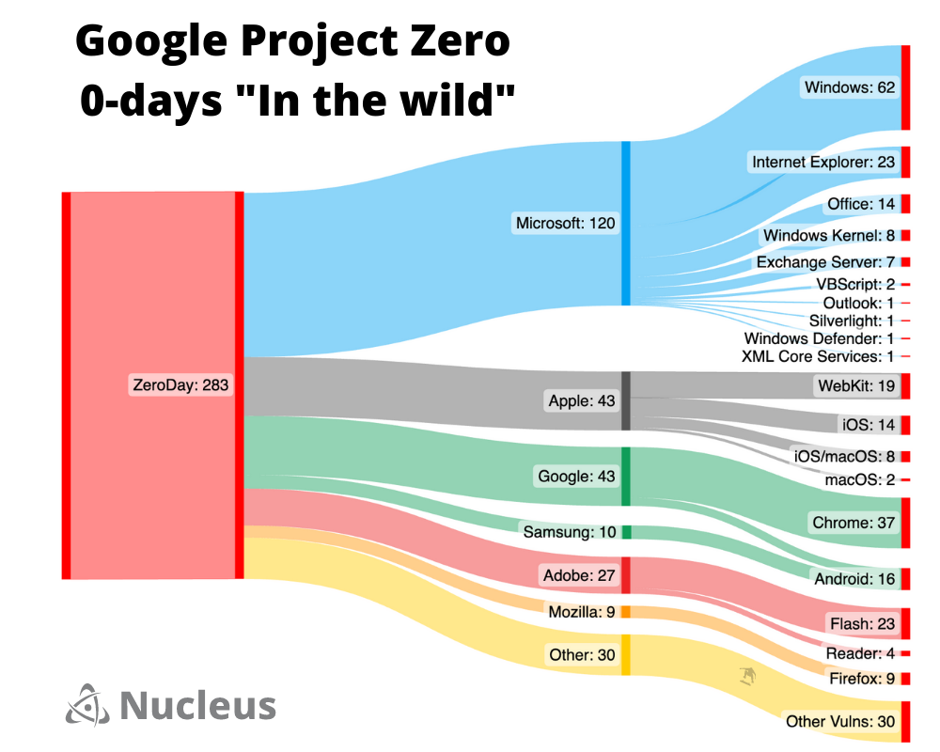
Created By: Patrick Garrity, Security Researcher, Nucleus Security
Notes:
Zero-Day Vulnerabilities have been a hot topic of discussion over the last decade. Media coverage often amplifies these vulnerabilities, contributing to a cascading effect that puts IT and security teams into a scramble to understand the potential impact on their environment, and at times for good reason.
Google's Project Zero has been diligently tracking publicly known zero-day exploits and has captured 269 of them over the past decade. This comprehensive list provides valuable insights. To put it into perspective, these 269 vulnerabilities account for only 0.125% of the total number of vulnerabilities in the National Vulnerability Database (NVD).
Digging deeper into the data, Google found that, on average, a new zero-day exploit 'in the wild' is discovered every 17 days. It's worth noting that these discoveries often clump together in exploit chains, meaning multiple vulnerabilities are found and disclosed simultaneously. We saw this just last week when Apple disclosed 3 zero-day vulnerabilities.
Furthermore, Google found that it takes an average of 15 days for vendors to patch actively exploited vulnerabilities that are currently under attack. This emphasizes the need for a swift response from organizations to secure their systems.
Additionally, it is noteworthy that memory corruption issues contribute to 68% of the listed CVEs.
Considering the consistent flow of zero-day vulnerabilities, it is important for organizations to establish a pro-active rapid vulnerability response plan for not only zero-days but all high-risk vulnerabilities.
LinkedIn Post URL: https://www.linkedin.com/posts/patrickmgarrity_cybersecurity-zerodayexploits-riskmanagement-activity-7066662985280204801-u7ha?utm_source=share&utm_medium=member_desktop

Slide 38
Security Team Considerations / Processes

Slide 39

Enterprise Vulnerability Management Responsibility Matrix
Asset
Example Vulnerability
Owner
EndPoint
Chrome - CVE-2023-2033
Endpoint Admin
Application
XSS Attack - CWE-79
Devops / Dev / SysAdmin
Source Code
Apache - Log4j
Developer
Server
Windows - CVE-2022-30190
Sysadmin
Container
Kubernetes - CVE-2022-2385
SysAdmin / Devops
Devops
Infrastructure
HP ILO - CVE-2022-28637
Infrastructure Admin
Networking
CISCO - CVE-2023-20046
Network Admin
Firewall / WAF
Sophos - CVE-2022-3236
Firewall Admin
Cloud Infrastructure
AWS S3 - Misconfiguration
Cloud / DevSecOps
Vulnerability Management / Product Security Teams
Created By: Patrick Garrity, Security Researcher, Nucleus Security
Notes:
One of the challenges in enterprise vulnerability management is achieving alignment across an organization. To establish this alignment, it is crucial for vulnerability management teams to have a clear understanding of responsibility and ownership.
To provide a better understanding into the the complexities of alignment in vulnerability management, I've created an enterprise vulnerability management responsibility matrix. This visual tool illustrates the mapping of assets, example real world vulnerabilities and the corresponding responsible team for asset maintenance, patching and mitigations.
I would greatly appreciate your feedback on this visual representation. Does the matrix effectively convey the importance of alignment and provide a clear understanding of responsibilities within enterprise vulnerability management? Are there any improvements or suggestions you have in mind?
https://www.linkedin.com/posts/patrickmgarrity_cybersecurity-riskmanagement-infosecurity-activity-7069048884999696385-T9M9?utm_source=share&utm_medium=member_desktop

